Slide 1
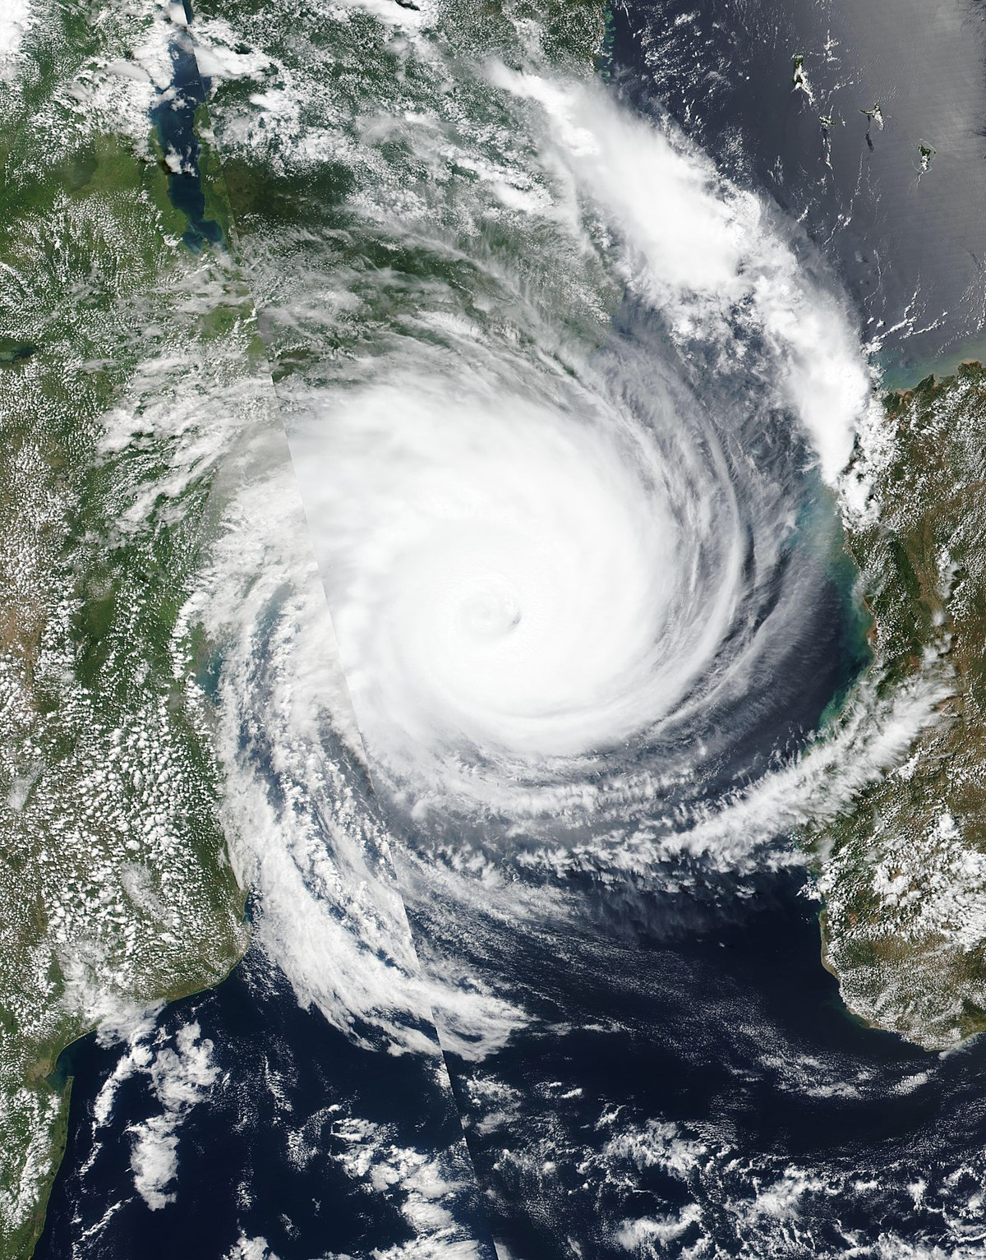
Enhancing the HIV Emergency Response
Tropical Cyclone Idai in Sofala province, Mozambique
Demand creation for HIV and TB treatment services
HIV Communication-centred Project

Slide 2
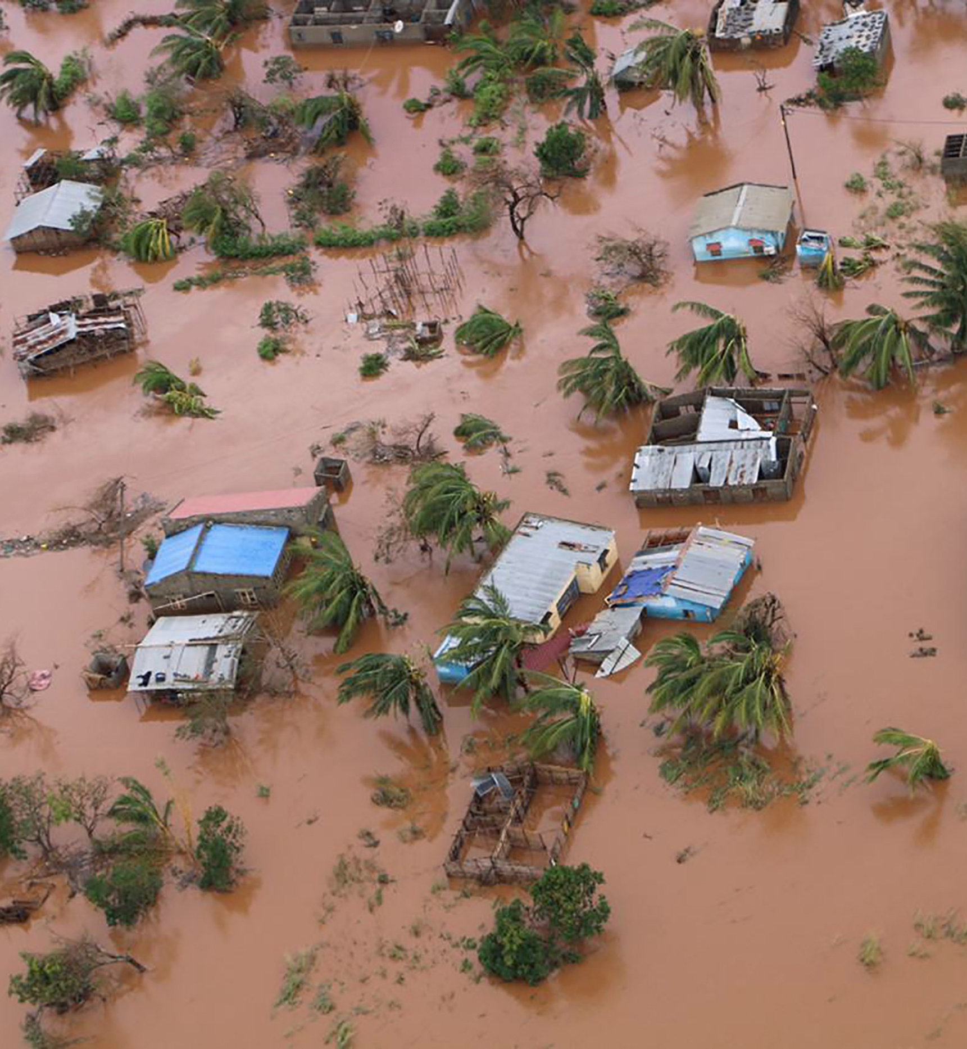
Background
Emergencies impact most drastically vulnerable groups in society, including PLHIV
Service disruption and continuum of care
Impact of destabilization/displacement on HIV risk
Notes:
Emergencies impact most drastically vulnerable groups in society, including people living with HIV (PLHIV). In emergency situations, food access and availability become very limited and health services are frequently disrupted, hindering access to life-saving HIV medication and adherence to treatment, leaving this vulnerable group in a difficult situation. Moreover, destabilised or displaced populations sometimes resort to commercial sex as a coping strategy, further increasing their risk to HIV infection.

Slide 3
Tropical Cyclone Idai
Tropical Cyclone Idai
Hit central region in March 2019 affecting Sofala, Manica, Tete and Zambezia
Emergency onset further exacerbated vulnerable community members’ conditions
PLHIV account for 16% of the population in Sofala
UNAIDS DOL
WFP/UNHCR Co-convene HIV services in humanitarian emergencies
Notes:
In March, tropical Cyclone Idai hit four central provinces of Mozambique, including Sofala, causing catastrophic damage. The onset of emergency further exacerbated vulnerable community members’ conditions, particularly PLHIV who account for 16% of the population in Sofala.

Slide 4
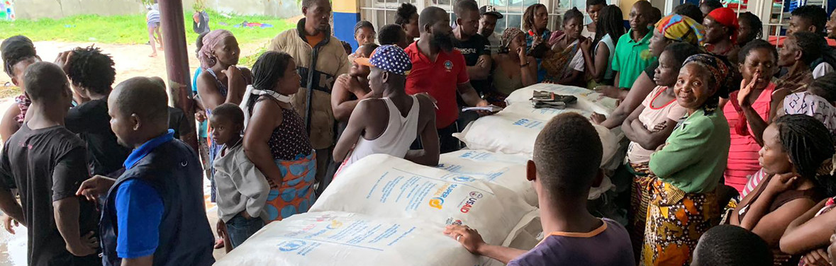
WFP Mozambique support to PLHIV
To ensure continuum of care and ensure adherence to treatment
Nutritional support to pregnant and lactating women and children under five with MAM through the National Management of Acute Malnutrition Program (Programa de Reabilitação Nutricional [PRN])
Scaling up this support to reach vulnerable groups, including PLHIV/TB
Notes:
WFP leveraged the current support to the MoH in Mozambique and designed a project to contribute to the expansion of services…

Slide 5
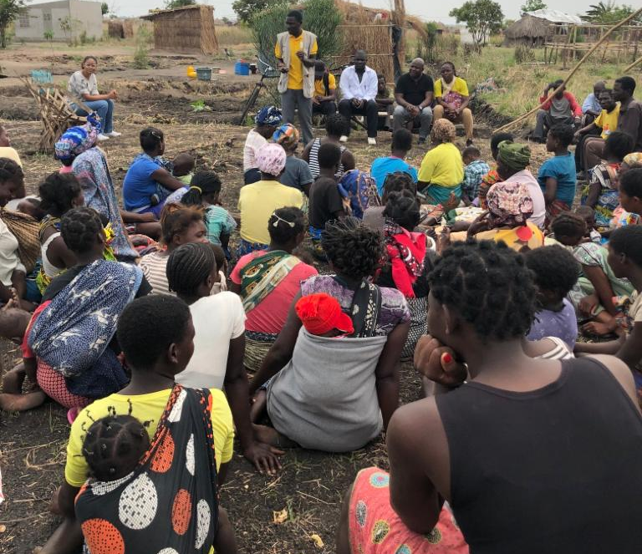
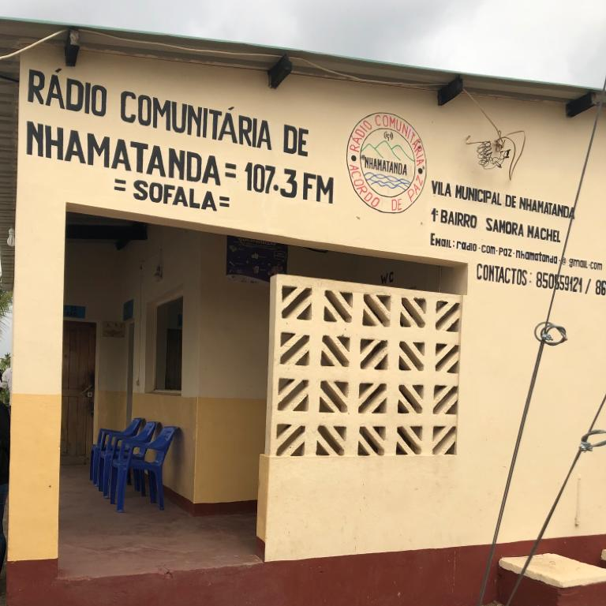
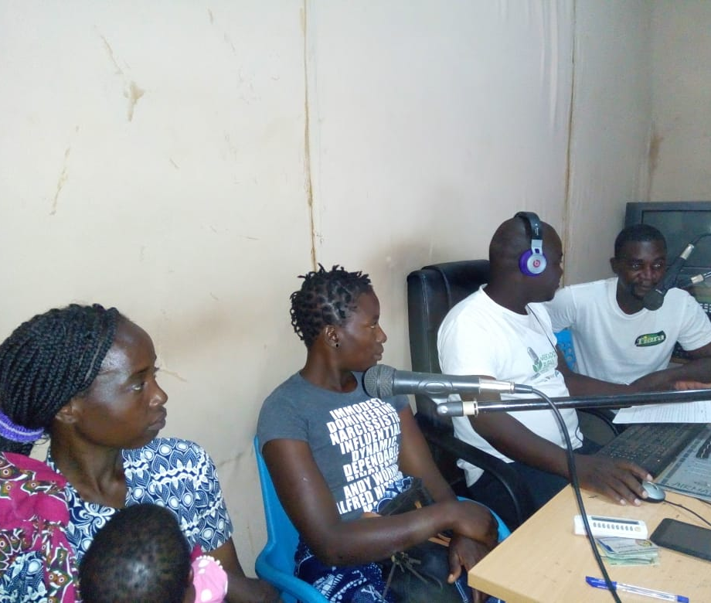
Media-centered support to PLHIV
Increase awareness regarding prevention, treatment and existence of HIV/TB services during the emergency
Partnership with H2N (local media agency)
6 Community radios
Community radio interventions:
  Radio spots
  Interactive radio programs
  Radio debates at communities
Notes:
Reach – Sofala province, 6 districts, 12 journalists
Topics covered: HIV/TB prevention for the general pops as well as for target groups PLW and CU5; Availability of treatment and prevention services, including testing and who should benefit from these, how are the services offered and so forth
Focus on PLW and CU5: Exclusive breast feeding in the context of HIV, Introduction of complementary feeding and continued breast feeding in the context of HIV, Appropriate feeding practices for CU5 in the context of HIV and maternal care and nutrition during pregnancy
Condition/Disease
Signs of HIV on affected people
Signs of undernutrition in PLW and CU5
Perceptions
Severity of HIV
Consequences of HIV
Benefits from HIV treatment

Slide 6
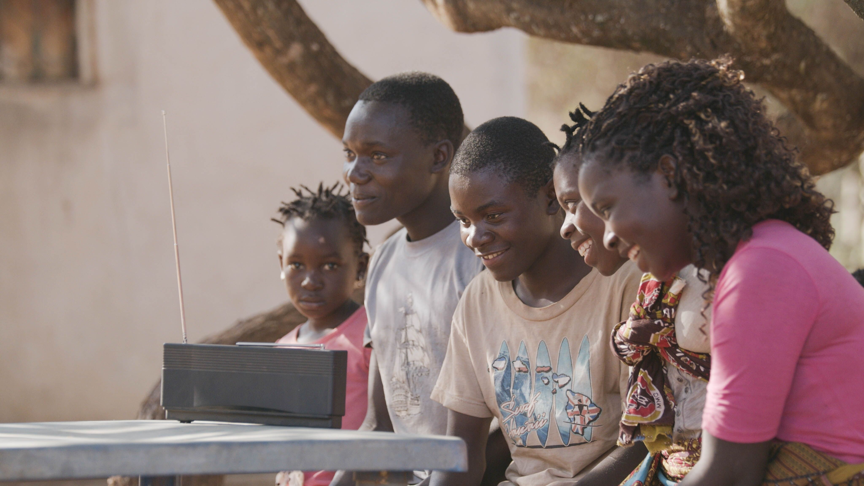
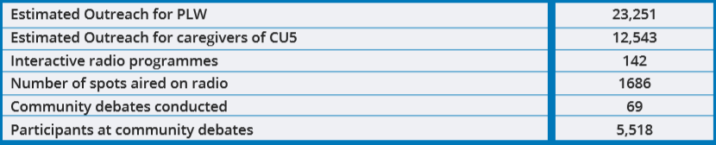
Progress to Date
Notes:
Table 1. Estimations for four months of intervention (Aug - Nov) on activities including estimated outreach (based on 70% of district receiving signal from radio channels)

Slide 7
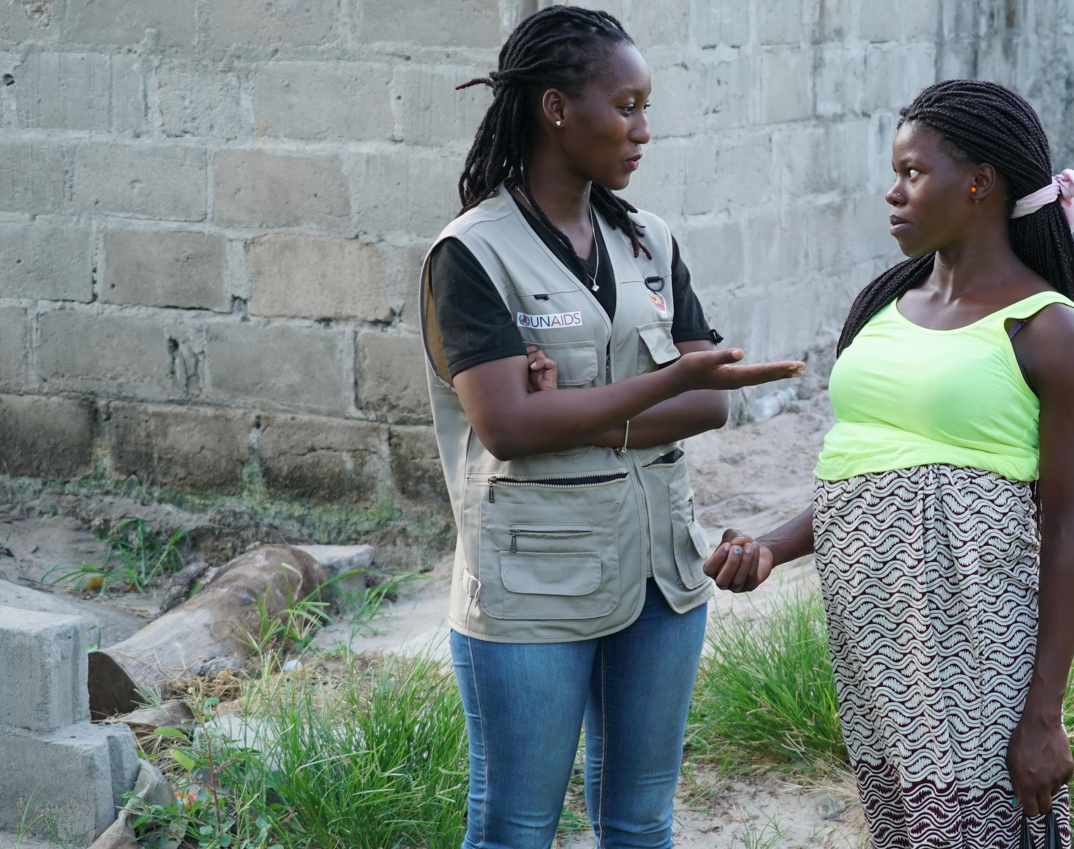
Key challenges
Short project timeframe
Limited technical knowledge of relevant topics by journalists
Notes:
Short project timeframe
Limited transport means
Technical knowledge of relevant topics by journalists
Prioritization of electoral coverage over program community debates

Slide 8
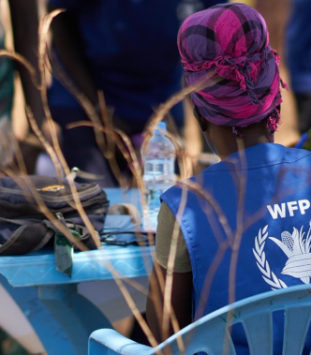
Lessons Learned
Consider all social and cultural norms that may influence project outcomes and importance of anonymity when sharing success stories – fear of stigma
Involvement of healthcare professionals crucial for
  Dissemination of appropriate and correct information
  Enhances credibility among community members
Notes:
Radio offers an effective and useful platform to disseminate information in emergencies as it is accessed by a large proportion of the population and requires minimal resources to operate compared to other means of communication
Public awareness can help guide public opinion, counter stigma and influence action and community mobilization. Considering journalists play a crucial role within this area, it is important to train them comprehensively on the subject area to enable them to cover and inform about the topic confidently and without error
It is crucial to consider all social and cultural norms that may influence project outcomes. Project designers and implementers need to consider the importance of anonymity when conducting such interventions due to fear of disclosure of HIV and associated stigma in the given population
Involvement of healthcare professionals in such a programme ensures dissemination of appropriate and valid information and enhances credibility among community members

Slide 9
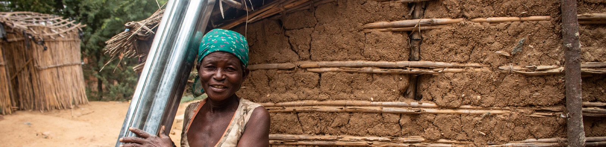
Lessons Learned cont..
Radio – effective and useful platform in emergencies
The involvement of community Journalists engage the audience in community debates. Ensure that beneficiaries actively participate in live shows in the community, acting – at the same time – as speakers and listeners.
Important to train community radio journalists comprehensively on subject area to
enable correct information disseminated
Notes:
1. Radio offers an effective way to improve health seeking behaviour and useful platform to disseminate information in emergencies as it is accessed by a large proportion of the population and requires minimal resources to operate compared to other means of communication. In emergencies, community radio is a successful channel for spreading
Accessed by large proportion of the population and Requires minimal resources to operate
Public awareness can help guide public opinion, counter stigma and influence action and community mobilization. Considering journalists play a crucial role within this area, it is important to train them comprehensively on the subject area to enable them to cover and inform about the topic confidently and without error
It is crucial to consider all social and cultural norms that may influence project outcomes. Project designers and implementers need to consider the importance of anonymity when conducting such interventions due to fear of disclosure of HIV and associated stigma in the given population
Involvement of healthcare professionals in such a programme ensures dissemination of appropriate and valid information and enhances credibility among community members

Slide 10



Thank you

