Slide 1
HIV and Humanitarian Response in Fragile Countries
Case of Venezuela
7 December 2019
Gary Jones, Senior Humanitarian Advisor, UNAIDS
UNAIDS | NOV 2019

Slide 2
When is an emergency an emergency?
Africa and Latin America
Coping - protecting
Thresholds of vulnerability; risk and resilience
Response by people in crisis; response by government; response by international actors
A backwards, a stagnation an ending

Slide 3
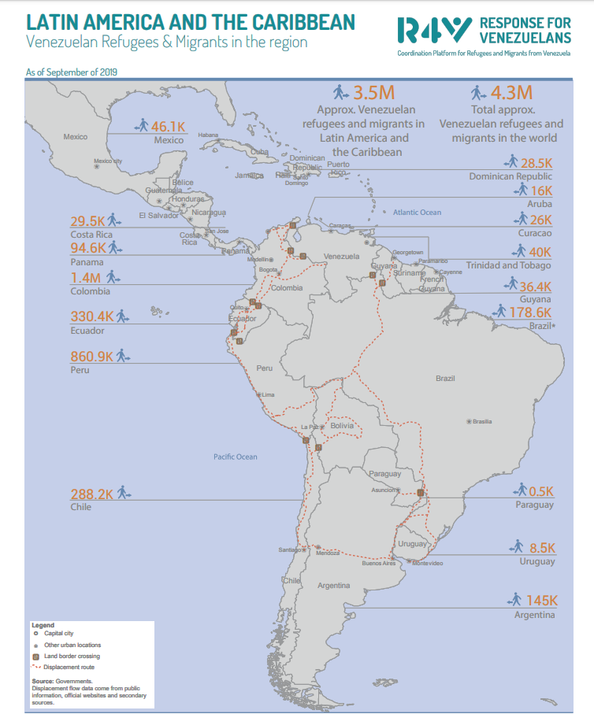

Slide 4
Humanitarian Overview - Venezuela
Venezuela faces a political, social and economic crisis - a complex humanitarian emergency affecting 95% of the population – the "silent emergency”
The official inflation rate in 2018 estimated at 130,060%
The humanitarian crisis is increasing due to growing lack of basic services
The most vulnerable are pregnant women, newborns, children under 5, people with chronic diseases - indigenous people. Border states have the highest needs

Slide 5
Migration
Since 2017 and until September 2019, more than
4.3 million Venezuelans left their country in search of food, health and housing.
The exodus is expected to exceed six million, or nearly 20 percent of the population of Venezuela, by the end of 2020;
Largest migration flow in the history of Latin America and the Caribbean.

Slide 6
People Living with HIV
The quality of life for PLHIV affected by lack of ART, diagnostic methods, breast milk substitutes and male and female condoms; many have experienced treatment breaks
There are 120,000 people living with HIV, with a prevalence of 0.62% (UNAIDS, Spectrum)
Between 2017 and 2018, shortages of ARVs and medications for opportunistic infections caused an increase in hospitalization rates and number of deaths (1,800 deaths in 2014 to more than 4,000 in 2018). Coverage of HIV and syphilis tests among pregnant women is 35%.
By December 2018, it was estimated that 7,700 PLWHA moved to neighboring countries seeking medication and better living conditions

Slide 7
Sexual & Reproductive Health
At Colombia border hospital (Erasmo Meoz), 8 out of 10 children born are from Venezuelan mothers; triple-digit increases in number of babies being delivered from Venezuelan mothers in the past two years; Adolescent pregnancies up by 65% since 2015 (UNFPA)
Hospitals report increase in both abortions and maternal deaths owing to unsafe abortions
HIV and sexually-transmitted diseases – due to the lack of condoms – are on the rise
Malnutrition in pregnant Venezuelan women; many babies born with malformations – due to malnutrition and/or a lack of vitamin supplements during pregnancy
Malnutrition, lack of prenatal care, and dangerous journeys to give birth outside Venezuela, mean over 60% of Venezuelan pregnancies in Colombia and other countries are considered high-risk

Slide 8
Regional Migration
Most Venezuelans who choose to leave – economic, security, or health reasons – journey overland often without documentation needed to find work or receive assistance
Many destination countries health, immigration and education systems are under increasing strain - resulting in social and legal barriers preventing Venezuelans from integrating. Chile, Peru, and Ecuador have now all restricted entry
Xenophobic attacks against Venezuelans range from Argentina, Peru, Ecuador to Trinidad & Tobago fueled by growing nationalism, civil unrest – beliefs that Venezuelans are criminals
The sexualization of Venezuelan women has led to an increase in gender-based violence
The UN’s most recent Refugee and Migrant Response Plan states:
“… families… face specific risks because of their age, gender, health or other needs, or because they had to make drastic choices to cope, including begging, sending their children to work or even resorting to survival sex.”

Slide 9
UN Actions
The UN Country Team before the crisis was made up by only 7 agencies; scale up of UN agencies in the country was activated in the last quarter of 2017
In May 2019, a Country Humanitarian Team was activated and a Humanitarian Response Plan (HRP) was designed to cover only 2.6 million of the population
The government does not formally recognize there is a humanitarian crisis, but possibility of "humanitarian needs.“

Slide 10
UNAIDS Actions
In June 2018, UNAIDS and PAHO developed a three-year Master Plan to strengthen the response to HIV, tuberculosis and malaria in Venezuela. The Master Plan mobilized US $ 5 million from the GFATM to buy ARV treatment (TLD) for approx. 85% of people who need treatment during 2019.
TLD was introduced since FEB2019 and is currently received by more than 32,000 PLHIV.
A new support of the GFATM for 6 MM has been approved
UNAIDS has worked as a channel to receive donation (ARV, diagnosis tests) from international NGOs. (In 2018 received US$5,532,900 in goods)
UNAIDS supports civil society activities of "social auditing" by monitoring the delivery of donated ARV and supports PLHIV to “navigate” the health system

Slide 11
RMRP for Refugees and Migrants from Venezuela 2020
Response Plan reflects complementarity with State-driven responses
Informed by: ▪ Joint needs assessments and analysis at national levels ▪ Joint identification of national priorities ▪ Consultations with national governments on priorities, assumptions
Dual focus (humanitarian-development-nexus): ▪ provision of humanitarian needs ▪ Focus on socio-economic integration of refugees and migrants, and support to host communities
Sector Approach – 7 UN agencies, 5 NGOs and the IFRC leading regional

Slide 12
UNAIDS and UNHCR Regional Collaboration
Strengthen national HIV response to include Venezuelan migrants and refugees
Training of the personnel of the national health services in Peru, Ecuador, Brazil, and Colombia
Promoting Support Spaces (EA) along refugee and migrant transit route
Commemoration of the World AIDS Day on the border of Colombia and Venezuela

Slide 13
The HIV Response – Key Issues
The challenge is keeping HIV and the rights of PLHIV as part of the response
Promoting good relations with government and non-government entities; building capacities of civil society within State institutions
Integrating HIV within the national response
Articulating with international NGOs and pharmacies to mobilize resources; mobilizing GFATM resources through the Master Plan from a Public Health Perspective“
Participating in Humanitarian Response Coordination mechanisms

Slide 14
Effective coordination. Lessons learned
Adapt to the context. Redefine priorities.
Maintain the relevance of HIV
Strengthen working relationship within the Joint Programme; highlighting key actions - promotion and use of rapid tests in pregnant women and tackling SGBV
Create and strengthen alliances with new key partners and stakeholders
Seize opportunities

Slide 15
The SDGs and Ending AIDS – and the humanitarian response
The Venezuelan crisis - a challenge to achieving the 90-90-90 targets in the region
The situation in Venezuela is affecting neighboring countries requiring regional cross-border coordination mechanisms to guarantee migrant access to sexual and reproductive health services - UNAIDS and PAHO the “Quito Process” for inclusion of ARV (TLD)
A new HRP is ongoing and would increase its coverage to 3.5 million people.
Joint Programme has projects to work with indigenous people with a high prevalence of HIV and TB
Promoting non-discrimination towards PLHIV and LGBTI at border crossings

Slide 16
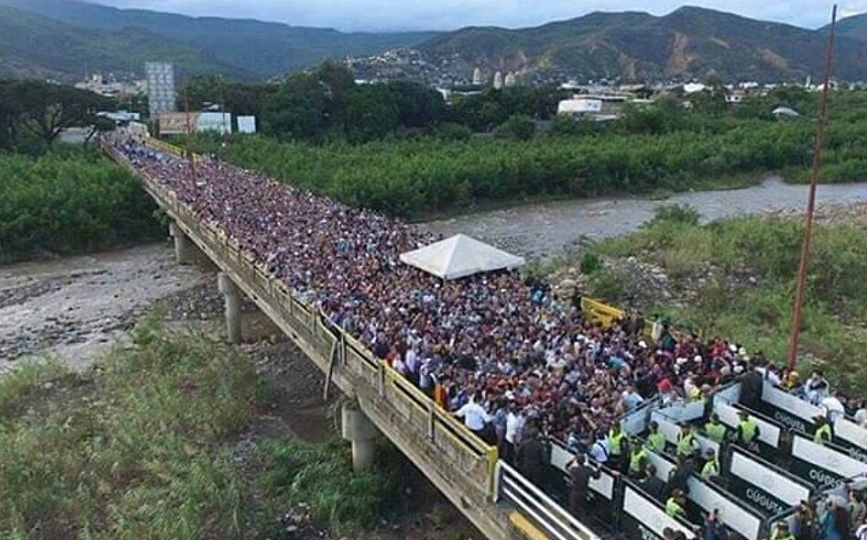

Slide 17
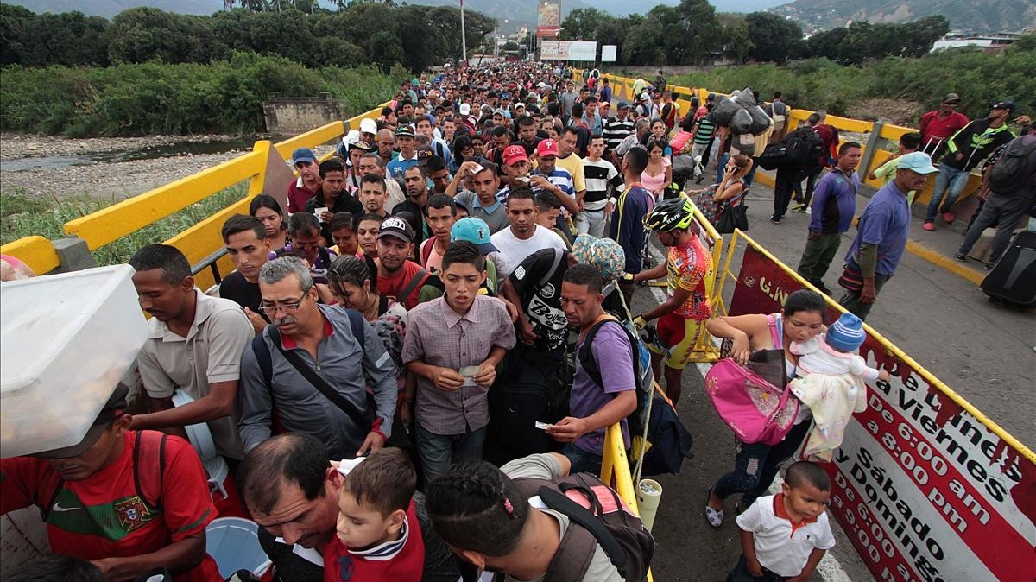

Slide 18
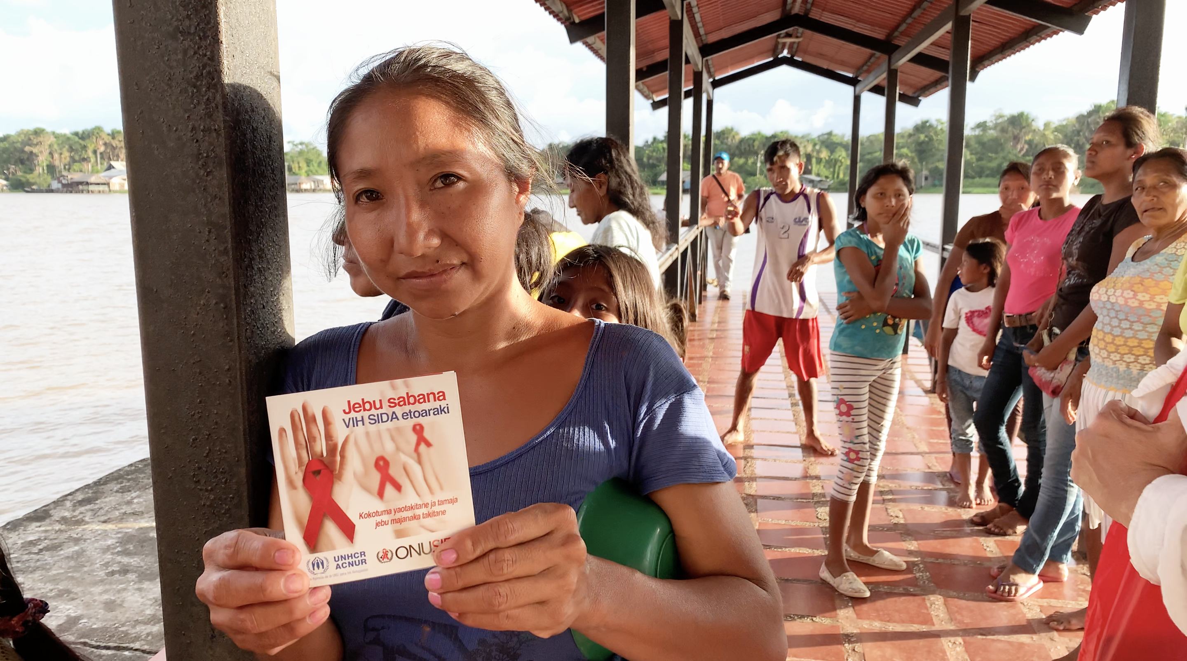

Slide 19
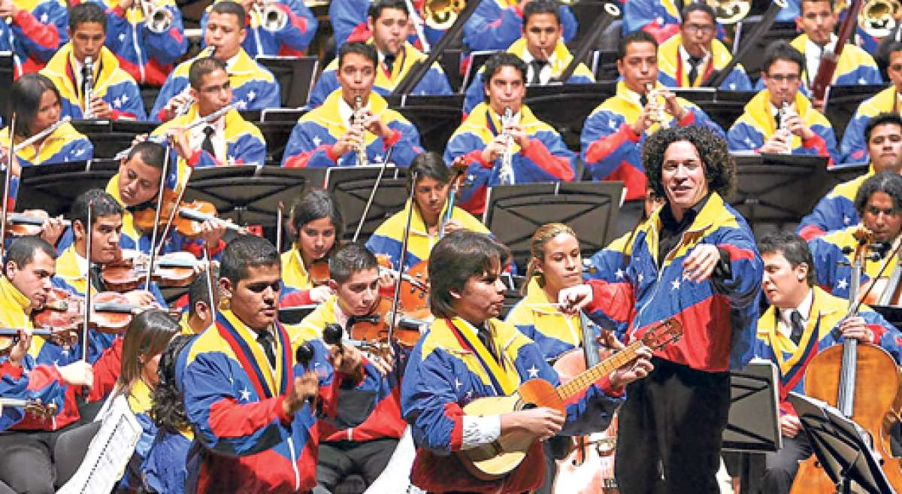
This is Venezuela

