Slide 1





HIV-Sensitive Social Protection: Harnessing SDGs for people living with HIV
Camille Wittesaele – Department of Social Policy & Intervention, Oxford University
WFP SATELLITE SYMPOSIUM | ICASA CONFERENCE
Notes:
•Going to talk about why HIV-sensitive SP and why it makes sense that the WFP is partnering in the agenda to end AIDS
•Evidence is telling us that social protection programming is able to benefit PLHIV
•Governments and countries are increasingly interested in maximising efficiency by leveraging resources and programming to end poverty and end AIDs.
•This is about extending the net of social protection programming to ALSO include specifically PLHIV
•HIV-S SP has the potential to help WFP achieve SDG2 while leaving no one behind!
Presentation today will discuss:
1.What is HIV-sensitive social protection?
2.Evidence: social protection for HIV Prevention + ART Adherence
3.New opportunity: SDGs
4.Emergency contexts: what we know
Revisit what we mean by HIV-S SP
Using evidence from cohort study in South Africa I’ll be sharing findings and evidence about how social protection provisions can prevent HIV risk + support those on treatment
Using the same data, we’ll consider the opportunity that the SDGs give to harness social protection intervention to improve outcomes for PLHIV
Finally – considerations for PLHIV in emergency contexts

Slide 2
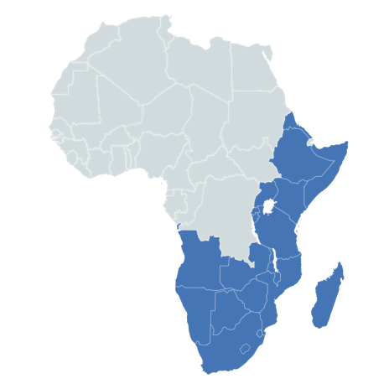
6 million people living with HIV in humanitarian emergencies
East and Southern Africa is the region most affected hit by HIV
50% of new infections occurred in eight countries in ESA in 2016
Notes:
UNAIDS’ Fast Track targets for 2020: 90% of people living with HIV know their status; of whom 90% are on treatment; of whom 90% are virally suppressed (90-90-90). Fewer than 500,000 new HIV infections annually (a 75% reduction since 2010)
: meet the SDG 3 target
2014 UNAIDS Fast-Track strategyto end AIDS by 2030. On the Fast-Track to Accelerate the Fight against HIV and to End the AIDS Epidemic by 2030' saw countries committing to targets that mirror UNAIDS’ Fast Track targets
2016 Political Declaration on Ending AIDS: Start Free, Stay Free, AIDS Free targets : focus on a lifecycle approach to reach children, adolescents and young men and women to prevent new infections, make treatment available and support people living with HIV
East and Southern Africa is the region hardest hit by HIV.
In 2016, 50% of new infections occurred in eight countries: Mozambique, Kenya, Zambia, Tanzania, Uganda, Zimbabwe, Malawi, and Ethiopia. South Africa accounted for one third (270,000) of the region’s new infections in 2016.
HIV prevention + treatment is important
https://www.avert.org/professionals/hiv-around-world/sub-saharan-africa/overview

Slide 3


What is social protection?
A set of interventions whose objective is to reduce social and economic risk and vulnerability, and to alleviate extreme poverty and deprivation (FAO).
Social protection is more than cash and social transfers such as food and vouchers. It encompasses economic support, social health insurance, employment assistance and social care to reduce poverty, inequality, exclusions and barriers to accessing social and medical services (UNAIDS)
Social protection systems help the poor and vulnerable cope with crises and shocks, find jobs, invest in the health and education of their children, and protect the aging population (World Bank)
All public and private initiatives that provide income or consumption transfers to the poor, protect the vulnerable against livelihood risks, and enhance the social status and rights of the marginalised; with the overall objective of reducing the economic and social vulnerability of poor, vulnerable and marginalised groups (Devereux & Sabates-Wheeler)
Notes:
All the 3 options above are correct. This is because there is a range of different definitions for social protection, but all recognised the importance of protecting the population throughout the life cycle in order to ensure equity and equality.

Slide 4
What are social protection provisions?
Menti
Notes:
All the 3 options above are correct. This is because there is a range of different definitions for social protection, but all recognised the importance of protecting the population throughout the life cycle in order to ensure equity and equality.

Slide 5
Structural deprivations → low adherence & loss to follow up in care
Violence
Stigma
Food insecurity
Travel distance
Risk factors for
non-adherence
& loss to follow up in care
Mental health issues
Transport costs
Caregiver illness
Disrupted family structures
Non-disclosure of HIV-status to children
Notes:
Structural deprivations are associated with low adherence and loss to follow up in care. Social determinants of health and structural barriers drive the HIV epidemic.
Social protection can interrupt structural barriers by:
Poverty reduction
Improving access to healthcare
Improving food security
Improving caregiver and family well-being
Social protection advances the AIDS response by addressing social and economic inequalities, stigma and discrimination which exacerbate HIV risk behaviors and vulnerability to HIV.
During the presentation, I will be sharing evidence demonstrating how various social protection provisions can interrupt these drivers.

Slide 6
How can HIV-sensitive social protection address structural deprivations?
Address social determinants of health and structural barriers that drive the HIV epidemic
Prevent, protect and promote: reduce risky behaviours and support adherence to ART
Notes:
HIV-S SP aim to address the inherent challenges that people at risk of HIV face and support those living with HIV to adhere to treatment.
Address social determinants of health – for example food insecurity has been associated with high-risk sexual behaviour, poor mental health and stigma have been identified as factors associated with risk for poor treatment adherence.
Prevent, protect and promote - addressing deprivations such as food insecurity + poor mental health and stigma may alleviate stressors that PLHIV face, (1) supporting their adherence to treatment, (2) preventing onward transmission and (3) promote overall health

Slide 7
Social protection provisions (care + cash) that address the inherent structural barriers faced by people living with HIV
Ensure that provisions are able to respond to the unique vulnerabilities of key populations
Notes:
When we talk about HIV-S Social protection provisions we consider those provisions that will address the vulnerabilities particularly faced by people at risk to and living with HIV
We need to think about “vulnerability” and ensure that provisions are able to respond to the unique vulnerabilities of these key populations
Cash: Cash transfers, health insurance, free HIV treatment, transport support programmes, decent employment, food and nutrition. Cash and vouchers, where appropriate, could be used as alternatives and complements to most types of in-kind assistance, including food aid, shelter materials, non-food item kits, seeds and tools and livestock
Care: Peer support, adherence support groups, violence and stigma prevention, social transformation element of social protection make it possible for people to demand and access quality HIV services.

Slide 8
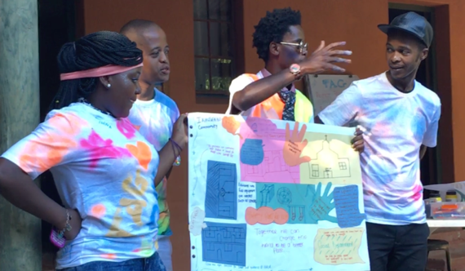
National survey (n=6000 adolescents, 2500 caregivers)
Longitudinal survey
Age: 10-17
3 provinces South Africa
Stratified random sampling of census EAs
Every household with a child aged 10-17
97% follow-up in 2 provinces
45% AIDS-affected
Teen Advisory Group
Measures
Standardised scales, school, sex, mental health, family, fun, violence…
Cluver, L, Orkin, M, Boyes, M et al (2013). Social Science and Medicine.
Notes:
Now we will present findings from two studies in South Africa. Firstly, we’ll present findings from a longitudinal cohort study conducted over two time-points:
Cohort study: 2009–2010 and 2011–2012
sample included: 6002 children aged 10–17 years
three provinces of South Africa
using stratified random sampling
Comparison groups included children orphaned by AIDS, orphaned by other causes and non-orphans, and children whose parents or primary caregivers were unwell with AIDS, unwell with other causes or healthy.
Participants reported on psychological symptoms, educational access, and sexual health risks, as well as hypothesized sociodemographic and intervening factors.
Parental HIV/AIDS impacts children through multiple interlinked pathways to psychological, education and sexual risks.

Slide 9
Social protection reduces girls’ HIV risk (n=3500)
No cash transfer
Child cash transfer
Cluver, Boyes, Orkin, Pantelic, Molwena, Sherr (2013). The Lancet Global Health.
Notes:
Cash transfers alone reduces girl’s HIV risk
case-control study
interviewed South African adolescents (aged 10–18 years) between 2009 and 2012.
randomly selected census areas in two urban and two rural districts in two provinces in South Africa ﻿(Mpumalanga and the Western Cape), including all homes with a resident adolescent.
We assessed household receipt of state-provided child-focused cash transfers, incidence in the past year and prevalence of transactional sex, age-disparate sex, unprotected sex, multiple partners, and sex while drunk or after taking drugs.
We used logistic regression after propensity score matching to assess the effect of cash transfers on these risky sexual behaviours.
Transactional sexual exploitation’ was sex in exchange for food, shelter, school fees, transport or money
‘age-disparate sex’ was having a sexual partner more than 5 years older than the adolescent
‘past-year initiation of adolescent sexual activity’ was first having vaginal or anal sex, with a partner of either sex in the past 12 months;
‘unprotected sex’ was ‘sometimes’ ‘rarely’ or ‘never’ using condoms when having sex in the past year (versus ‘always’ using condoms or no sexual activity);
‘multiple sexual partners’ was having more than two past-year partners
‘casual partners’ was having ‘one-night stands’ or sexual partners who were not regular boyfriends/girlfriends;
‘sex whilst using substances’ was having sex whilst drunk or using any drug (e

Slide 10
Cash + care reduces adolescent HIV risk incidence (n=3500)
Cash alone: OR .63
Cash plus care: OR .55
Cash alone: no effect
Cash plus care: OR .50
Cluver, Orkin, Boyes, Sherr (2014). AIDS.
Notes:
Then we tested whether ﻿cumulative ‘cash AND care’ interventions can reduce HIV risk behaviour
HIV risk = Transactional sexual, age-disparate sex, past-year initiation of adolescent sexual activity, unprotected sex, multiple sexual partners, casual partners, sex whilst using substances
We found that combinations are stronger in boys and girls: Combinations have greater potential for improving health outcomes than cash or care interventions alone. Integrated cash plus care reduces male and female adolescent HIV-risk behaviours. Increasing adolescent access to social protection may be an effective HIV prevention strategy in Sub-Saharan Africa.
﻿Risk behaviours were combined into a scale, and dichotomised as one or more HIV-risk behaviour versus
Cash (i.e. economic support):
‘Child-focused cash transfer receipt’ was measured as household access to either a child support or foster child grant
‘School feeding’ was daily, free meals provided at school, and ‘free school transport’ and ‘free school uniform’ were also measured;
‘access to food gardens’ was receiving food from a school or community garden;
‘food parcels’ were regular, reliable provision offood parcels to the household.
Soup kitchen feeding’ was regular provision of free meals from a community centre.
Care (i.e. psychosocial support):
‘Home-based carer support’ was at- least monthly household visits from a home-based caregiver, nurse or volunteer providing medical and social support.
‘Teacher social support’ was social, practical and emotional support from a teacher,
‘School counsellor’ was past-year school-based counselling
‘positive parenting’ was measured AP Scale included primary caregiver praise and warmth.
**‘Free schooling’ was measured, but not included in this analysis due to local reports of extensive obligatory ‘top-up’ payments.

Slide 11

Mzantsi Wakho (n=1500 adolescents)
3 - wave of adolescent cohort
1000 adolescents living with HIV
500 HIV-uninfected
Eastern Cape health district, South Africa
Every adolescent ever initiated ART
72 health facilities, 180 communities
Clinical data, questionnaires
94% 3-year retention
Cluver, L, Toska, E, Orkin, M et al (2016). AIDS Care
Notes:
Then we wanted to examine how social protection may support adolescent in sub-Saharan Africa.
I will present findings from Mzantsi Wakho. We will look at how HIV-sensitive social protection may (1) reduce risk among adolescents living with HIV and (2) support adherence.

Slide 12
HIV-sensitive social protection: HIV prevention
Cash + care + clinic: positive prevention (n=500)
Toska, Cluver, Boyes, Isaacsohn, Hodes, Sherr (2017) AIDS & Behaviour

Slide 13
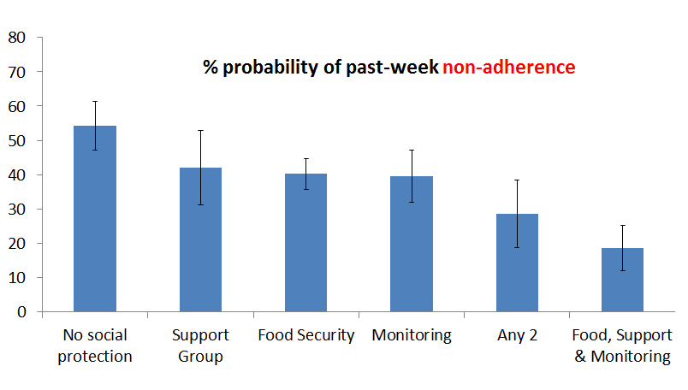
HIV-sensitive social protection: ART Adherence
Cash + care + clinic: lower non-adherence (n=1060)
Cluver, Toska, Orkin, Meinck, Hodes, Yakubovich, Sherr, AIDS Care 2016
Notes:
Cumulative additive effects of combining cash and care provisions

Slide 14

Accelerators to reach SDG targets for PLHIV
Notes:
We used data from cohort of 1000 ALHIV to see what risk reductions we might get and how these could impact on SDG targets
we can harness the SDG agenda to make political commitments towards HIV-sensitive social protection

Slide 15






School feeding: SDG outcomes
SCHOOL PROGRESSION
96% (93-98%)
SCHOOL PROGRESSION
97% (95-99%)
NO COMMUNITY VIOLENCE
49% (43-55%)
No Free meals
NO ABUSE
35% (29-41%)
NO COMMUNITY VIOLENCE
57% (52-63%)
NO ABUSE
43% (37-49%)
NO HIGH-RISK SEX
73% (67-79%)
FREE MEALS
HIV CARE RETENTION
69% (63-74%)
NO HIGH-RISK SEX
79% (74-84%)
N=1,000 ALHIV marginal effects of logistic regressions controlling for baseline SDG outcome, other potential accelerator, and socio-demographic variables
HIV CARE RETENTION
78% (69-83%)
Notes:
Associations of individual accelerator and combined ‘accelerator synergy’ provisions with SDG-aligned targets
marginal effects models with covariates held at their mean values¹
Data are percentage probability (95% CI)
3.8 Access to essential health-care services: Retention in care
4.1 All girls and boys complete primary and secondary education: Enrolled at school
5.6 Universal access to sexual and reproductive health: No high-risk sex
16.1 Reduce all forms of violence and related deaths: No community violence
16.2 End violence against children: No emotional or physical abuse
Associations of individual accelerator and combined ‘accelerator synergy’ provisions with SDG-aligned targets: marginal effects models with covariates held at their mean values¹

Slide 16
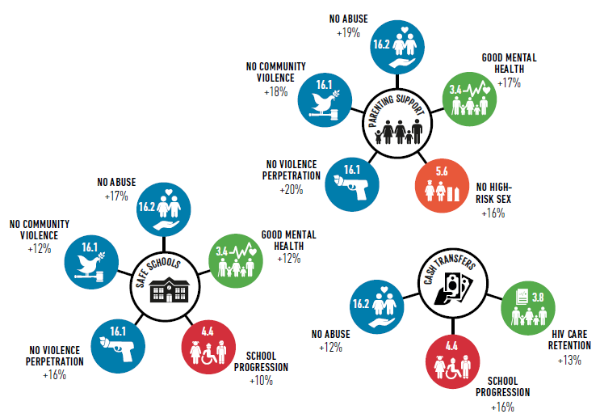
Development accelerators
% IMPROVEMENT ON INCIDENCE RATE OF SDG TARGETS
N=1,000 ALHIV marginal effects of logistic regressions controlling for baseline SDG outcome, other potential accelerator, and socio-demographic variables
Notes:
Concept of accelerators: single interventions that target multiple SDG targets
We tested this model of accelerators to see how they improvec reaching SDG targets in adolescent living with HIV sample.
Found significant associations with multiple target

Slide 17
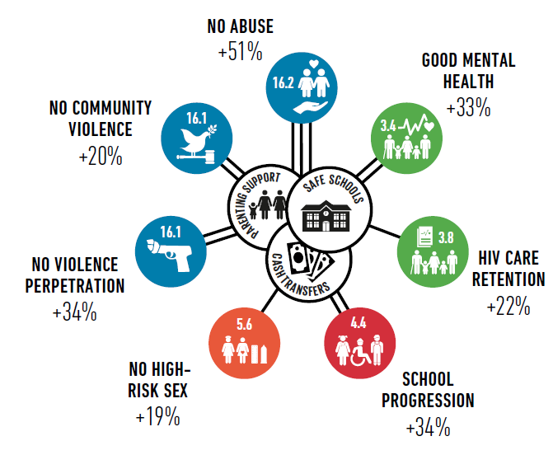
SUPER-ACCELERATORS
GAINS ACROSS MULTIPLE DEVELOPMENT DOMAINS
N=1,000 ALHIV marginal effects of logistic regressions controlling for baseline SDG outcome, other potential accelerator, and socio-demographic variables
Notes:
What happens if we combine multiple “accelerator interventions?” – additive effects across multiple targets
SDG agenda seeks to build synergies and linkages between SP and SDG targets.
This is an opportunity for co-programming on HIV, SP and wider humanitarian agenda

Slide 18
Accelerator impacts on violence
N=1,000 ALHIV marginal effects of logistic regressions controlling for baseline SDG outcome, other potential accelerator, and socio-demographic variables
Notes:
Taken analysis further to look at violence outcome
Food security – do adolescent reporting 2 or more days without foods at home
Parenting support – child monitoring, supervision and positive parenting
Violence victimisation - exposure to community violence (seeing community violence, seeing someone shot or stabbed)
Law breaking (i.e. youth violence perpetration) – do you carry a weapon, are you in a gang, do you get into fights
Impact on multiple outcomes
2 lines = both have impact on the
Proportions are prevalence difference

Slide 19
Social Protection improves HIV prevention, treatment and care for children and adolescents.
CASH (including food provisions) + CARE social protection delivered at HOME, SCHOOLS and CLINICS have additive effects.

Slide 20

Evidence scarcity: HIV-sensitive social protection in an emergency
Notes:
Urgent need for improved coherence between humanitarian and development actions.
Social protection programming offers a long-term and sustainable responses for vulnerable populations including crisis-affected people
This is an opportunity to enhance the resilience of vulnerable populations, may help them respond to risk and shocks and promote livelihood.

Slide 21



How does this evidence translate in emergency settings?
Scarce evidence and impact analyses for HIV in humanitarian settings
There is strong evidence that social protection provisions can reduce HIV risk behaviors, improve retention in care and promote treatment adherence
Potential to harness the SDG agenda to meet needs of PLHIV in humanitarian settings
Notes:
How does this evidence translate in emergency settings?
Evidence is needed to ensure that programmes and services are designed to effectively meet structural deprivations faced by PLHIV in emergencies
Impact analyses are scarce - analysis has been done for social protection and TB, but not HIV.
Evidence is needed to ensure that programmes and services are designed to effectively meet structural deprivations faced by PLHIV in emergencies

Slide 22



What evidence do we need for HIV-sensitive social protection programming in humanitarian settings?
Considerations:
HIV inclusive vs. HIV specific
Conditionality
Delivery channels
Integration & combination of provisions
FOOD SECURITY
NUTRITIONAL SUPPORT
EDUCATION
Source: https://www.unaids.org/sites/default/files/media_asset/jc1767_iasc_doc_en_0.pdf
Notes:
WFP can support the programme design and implementation of cash-based and in-kind transfers coupled with psychosocial support.
Ensuring optimal nutritional status and food security among the most vulnerable, is pivotal to achieving zero hunger.
Such design can focus on conditionalities, transfer modalities, delivery channels- to promote economic empowerment, adherence to treatment and reduce negative coping mechanisms (school drop-out, and transactional and age- disparate sex).
HIV specific vs inclusive: Unconditional preferable for effectiveness reducing stigma and discrimination; Co-financing & integration to avoid missed opportunities
Guidelines for addressing HIV in humanitarian settings:
Food insecurity → increases sexual risk behaviours particularly among women. Restoring household assets + local food production can provide safety net to prevent risk and reduce impact of shocks
Nutritional support → PLHIV experience specific vulnerabilities that may increase risk of malnutrition. Nutrition care programmes should expand and be integrated with other services supporting PLHIV
Education → education is part of the emergency preparedness plan. This may provide opportunities to provide care (counselling, peer support) to children and young people living with HIV.

Slide 23
THANK YOU

Slide 24

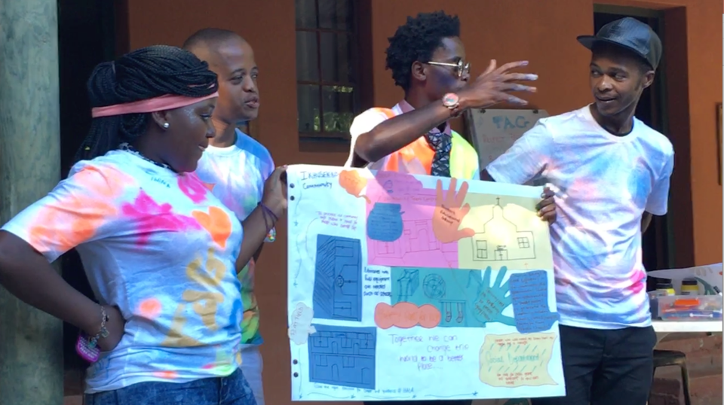



























Slide 25
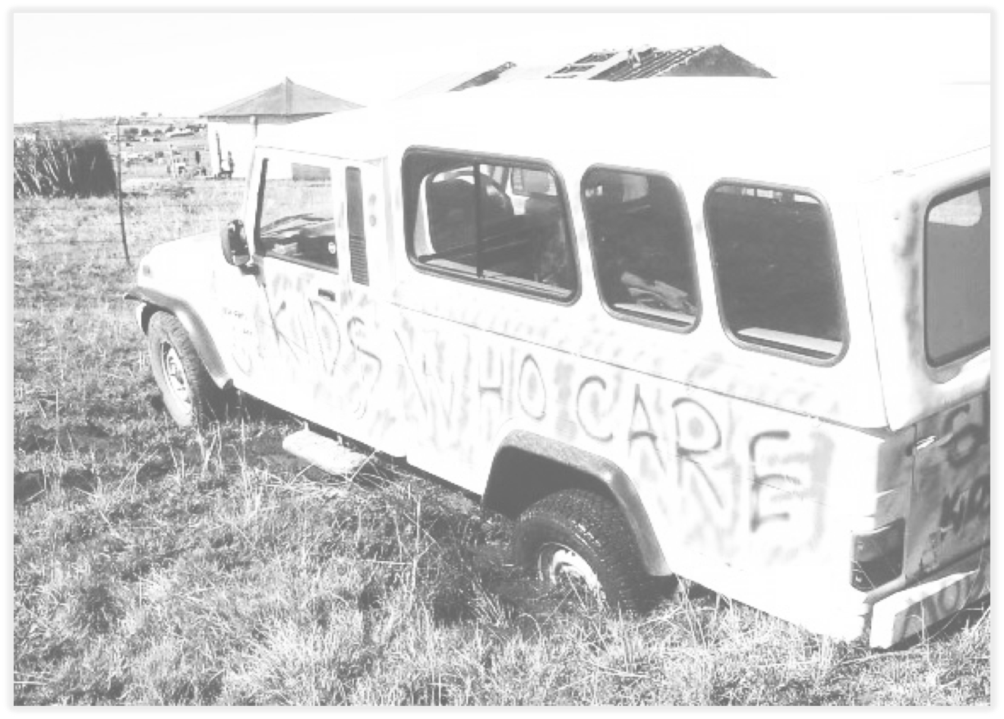
INCREDIBLE TEAMS & TEENS
Analysis and writing: Lucie Cluver, Rebecca Hodes, Elona Toska, Lesley Gittings, Roxanna Haghighat, Mark Orkin, Siyanai Zhou, Marija Pantelic, Lorraine Sherr, Mark Boyes, Franziska Meinck, Helen Natukunda, Eda He, Laurence Campeau, Craig Carty, Mosa Moshabela.
Oxford team: Camille Wittesaele, Sally Medley, Maria Michaloupoulou, Jenny Doubt, Lizzy Button, Anna Carlqvist, Sarah Hoeksma, Colleen Kelly, Vince Evans Gutierrez, Melissa Pancoast, Amogh Sharma, Louis Pilard, Alexa Yakubovich.
UCT team: Marius Coqui, Nondumiso Hlwele, Thobani Ncapai, Sarah Walters, Fundiswa Menziwa, Nozuko Boqwana, Noxolo Myeketsi, Siyanai Zhou, Jane Kelly.
Field team: S Banzana, O Barns, P Bellem, W Booi, N Boqwana, M Boyes, N Bungane, L Button, L Campeau, A Carlqvist, M Casale, C Carty, KE Chademana, L Cluver, M Coqui, J Doubt, M Dukata, Y Dunkley, C Dyer, A Egan, N Ella, J Ellis, V Evans Gutiérrez, N Galela, C Gilmer, L Gittings, N Gwebecimele, R Haghighat, E He, A Heusel, N Hlwele, R Hodes, S Hoeksma, N Homani, M Isaacsohn, V Jali, Z Jantjies, J Jochim, R Jopling, C Kama, B Kamile, C Kelly, B Kinana, P Kom, V Luke, O Madikane, B Madondo, S Mahleza, K Makabane, B Makwenkwe, T Mampangashe, Z Marikeni, D Mark, X Matebese, A Mayekiso, A Mbiko, A Mboyiya, S Mbula, N Mdi, F Meinck, D Mhlauli, B Mkati, S Medley, F Meinck, N Mendu, F Menziwa, P Mngese, S Mngese, P Mjo, S Mona, M Moshabela, T Moyikwa, S Mpimpilashe, M Mpumlwana, S Mqalo, Z Mqhashane, S Mwellie, N Myeketsi, P Myoyo, H Natukunda, T Ncapai, M Neel, U Ngesi, S Ngozi, P Nobatye, N Nurova, A Nyamweda, M Orkin, M Pancoast, M Pantelic, L Parmley, L Pilard, T Ramncwana, A Robb, J Rosenfeld, B Saliwe, J Sandelson, I Savage, D Sephula, N Shah, A Sharma, L Sherr, N Sibanda, L Sidloyi, M Simandla, U Simandla, N Simaya, I Skracic, R Smith, N Sontsonga, J Steinert, X Swelindawo, B Taleni, M Thabeng, E Toska, S Tshaka, T Tsiba, B Vale, J Van der Wal, T Walker, S Walters, P Wardle, C Wittesaele.
Clinic team:Nontuthuzelo Bungane, Amanda Mbiko, Zoliswa Marikeni, Pumza Bellem.
Research assistants: N Bhambra, N Bobrowitz, K Kidia, A Naik, A Redfern, A Yakubovich, M Berezin, L Campeau, S Malunga, KE Chademana.

